Slide 1

EDA of Unicorn Companies
Oluwakemi Akintan

Slide 2
Overview
Unicorn Companies
Private companies with a valuation over $1 billion as of March 2022, including each company's current valuation, funding, country of origin, industry, select investors, and the years they were founded and became unicorns.

Slide 3
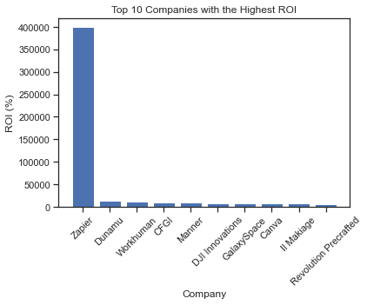
Top 10 Companies with Highest ROI

Slide 4
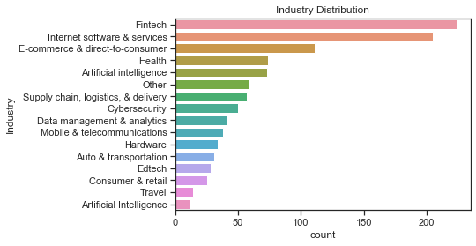
Distribution of Industries

Slide 5
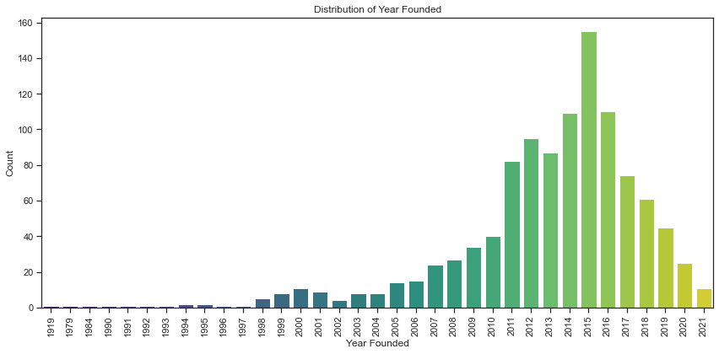
Distribution of Year Founded

Slide 6
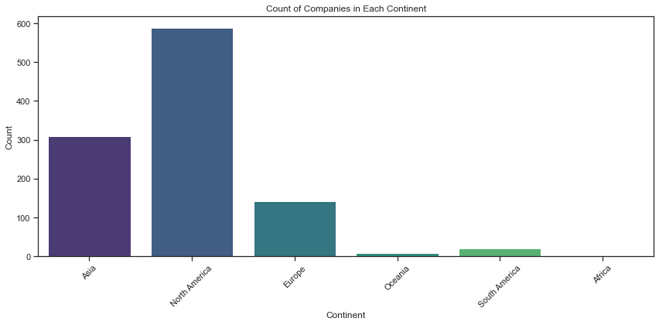
Companies in each Continent

Slide 7
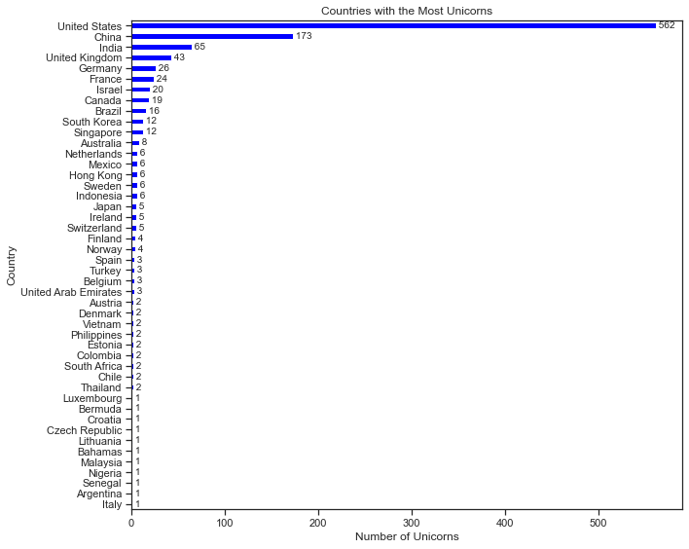
Countries with the most Unicorns

Slide 8
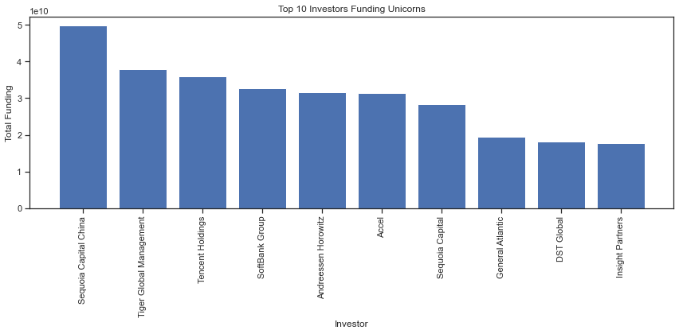
Investors Funding Unicorn

Slide 9
Recommendations
Fintech companies would provide more ROI for investors.
Leverage location in establishing companies for profits as there would be established structure and infrastructure supporting the company.
Investors could also focus on other sectors (AI, Health, cybersecurity etc.) that would yield ROI.
The funding available to companies would determine the valuation and this would enhance how long it would take to become a unicorn and not necessarily when they were established.

